Slide 2
God’s Heart for the Marginalized
Missions Month Week #3 Message
Luke 4:14-30
© March 18, 2018
Abe Park
Notes:
2

Slide 3
“The Spirit of the Lord is upon me, because he has anointed me to proclaim good news to the poor. He has sent me to proclaim liberty to the captives and recovering of sight to the blind, to set at liberty those who are oppressed, to proclaim the year of the Lord's favor.”
– Luke 4:18-19

Slide 4
According to Luke, Jesus’ first public announcement claims that he is the fulfillment of the Old Testament prediction. The messiah has come and with him the new era of the “Lord’s favor”—the kingdom of God.

Slide 5
Here is the particular message which made the people of Nazareth Angry. Jesus was saying to them that often in the history of Israel it had been shown that God’s goodness could not be appropriated by those who thought they had a special claim on God, but that it went out to all those who were eager and receptive—and those who were thus eager might be not those of orthodox privilege, but the stranger and the alien. Always there is a tendency to resent that. A church wants to keep its religious privileges to itself; it does not want to be annoyed with unduly difficult claims for Christian missions.

Slide 6
The congregations’ business, it thinks, is to nurture its own life, and moreover, it is God’s business that this previous life of its own should be thus nurtured. Men who decide the policies of nations in their legislative assemblies often have the same idea; whatever happens, the nation’s special interests must stand first. Anyone who suggests that other peoples of the earth might be equally important in God’s sight is to be pushed aside as an intolerable nuisance.
(The Interpreters Bible: Luke, p. 95)

Slide 7
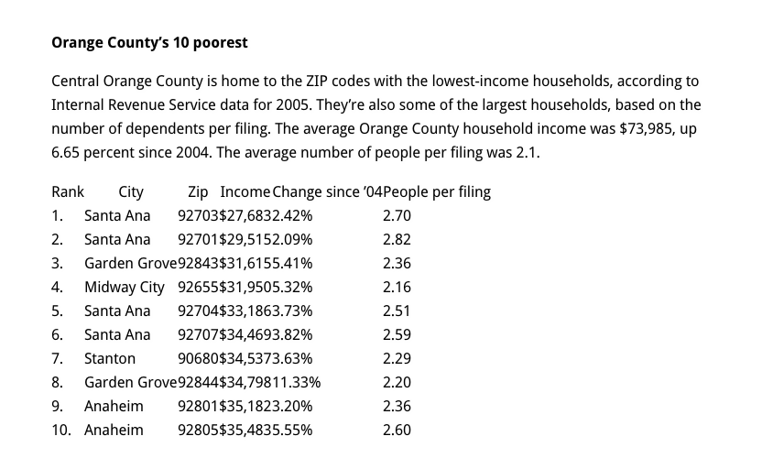

Slide 9
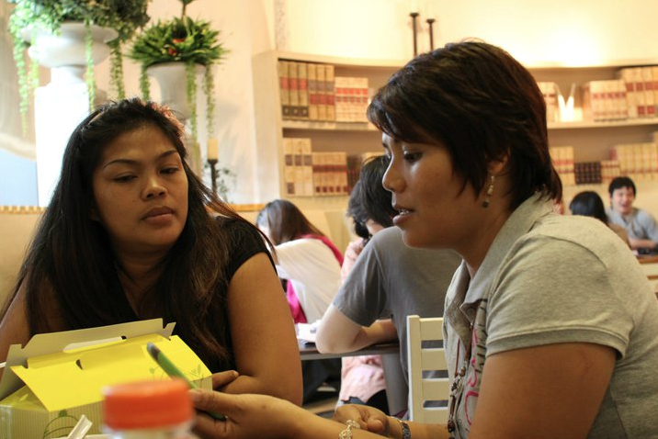

Slide 11
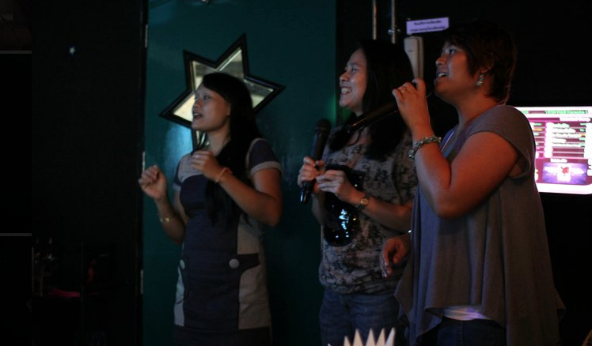

Slide 13
THREE PRACTICAL QUESTIONS FOR OUR EVERYDAY LIFE
What has God taught you about his heart and his Kingdom today?
In your life, who are the marginalized? Who has God placed on your heart?
They are waiting for hope, what next steps can you take towards loving them in person or in the flesh (incarnational ministry)?

